Slide 1


SAVITRIBAI PHULE PUNE UNIVERSITY
Project Presentation on
“PIEZOELECTRIC POWER GENERATOR”
SUBMITTED BY
Akshay kadam 72158775F
DEPARTMENT OF ELECTRONICS AND TELECOMMUNICATION
NBN SINHGAD TECHNICAL INSTITUTES CAMPUS
10/1, AMBEGAON (BK), PUNE-411041
Y. 2022−2023

Slide 2
CONTENT
INTRODUCTION
PROBLEM STATEMENT
OBJECTIVE
HARDWARE REQUIRED
SOFTWARE REQUIRED
BLOCK DIAGRAM
FLOWCHART
DESCRIPTION
FUTURE SCOPE
CONCLUSION

Slide 3
INTRODUCTION
Now a days, electricity has become a need of every single human, demand of electricity increasing day by day.
This new generation needs lots of electrical power for their different operations. There are various ways to generate electricity.
Piezoelectricity was discovered by Curie brothers in 1880. It is the generation of electric field from applied pressure.
It is observed in crystalline materials with no inversion symmetry.
The materials exhibiting the direct piezoelectric also exhibit the reverse piezoelectric effect (the internal generation of a mechanical strain resulting from an applied electrical field).
usually ambient vibration and transform it into electrical energy that can be used to power other devices.

Slide 4
PROBLEM STATEMENT
The problem at hand is to improve the performance and address the limitations of piezoelecteic generation system for efficient energy harvesting.

Slide 5
OBJECTIVE
Harvesting clean energy from a renewable source of energy like the vibrations in sourrounding created by every moving object has been the belief of the researcher.
Study presents the effectiveness of mechanical energy as it is used to generate another form of energy (electricity).
Anywhere it can be implemented as it require’s vibration mostly in crowdy area’s it is effective
It would be able to operate effectively in unknown environment.

Slide 6
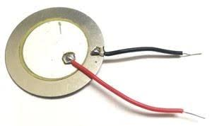
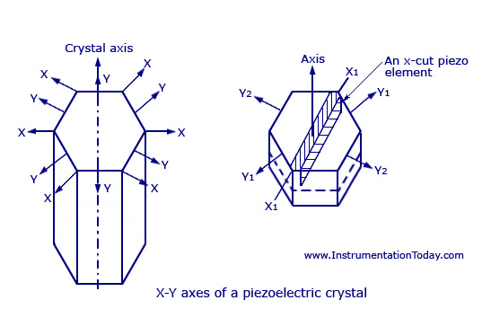
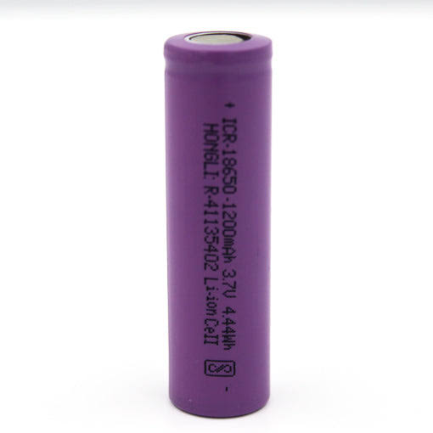
HARDWARE REQUIRED
Piezo Electric Crystal:
Piezoelectric crystals are capable of the piezoelectric effect, which is the
ability of a material to generate an electric charge when subjected to
pressure. There are both natural and synthetic materials with this
potential.
Battery (3v rechargable battery)
A rechargeable battery, storage battery, or secondary cell (formally a type of energy accumulator), is a type of electrical battery which can be charged, discharged into a load, and recharged many times
Notes:
Arduino Uno: A popular microcontroller board that serves as the brain of the system, responsible for processing RFID data, controlling the solenoid lock, and managing the overall system operation.
RFID Reader: An RFID reader module that communicates with RFID tags and reads the data stored on them. The type of RFID reader used will depend on the frequency and format of the RFID tags being used in the system.
RFID Tags: RFID tags, also known as RFID cards or RFID key fobs, which are attached to objects or carried by users for identification. The type and quantity of RFID tags will depend on the number of authorized users and the specific application requirements.
Solenoid Lock: A solenoid lock or an electric lock that can be controlled by the Arduino to lock or unlock the door. The type of solenoid lock used will depend on the type of door and security requirements.

Slide 7
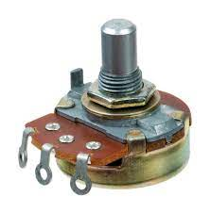
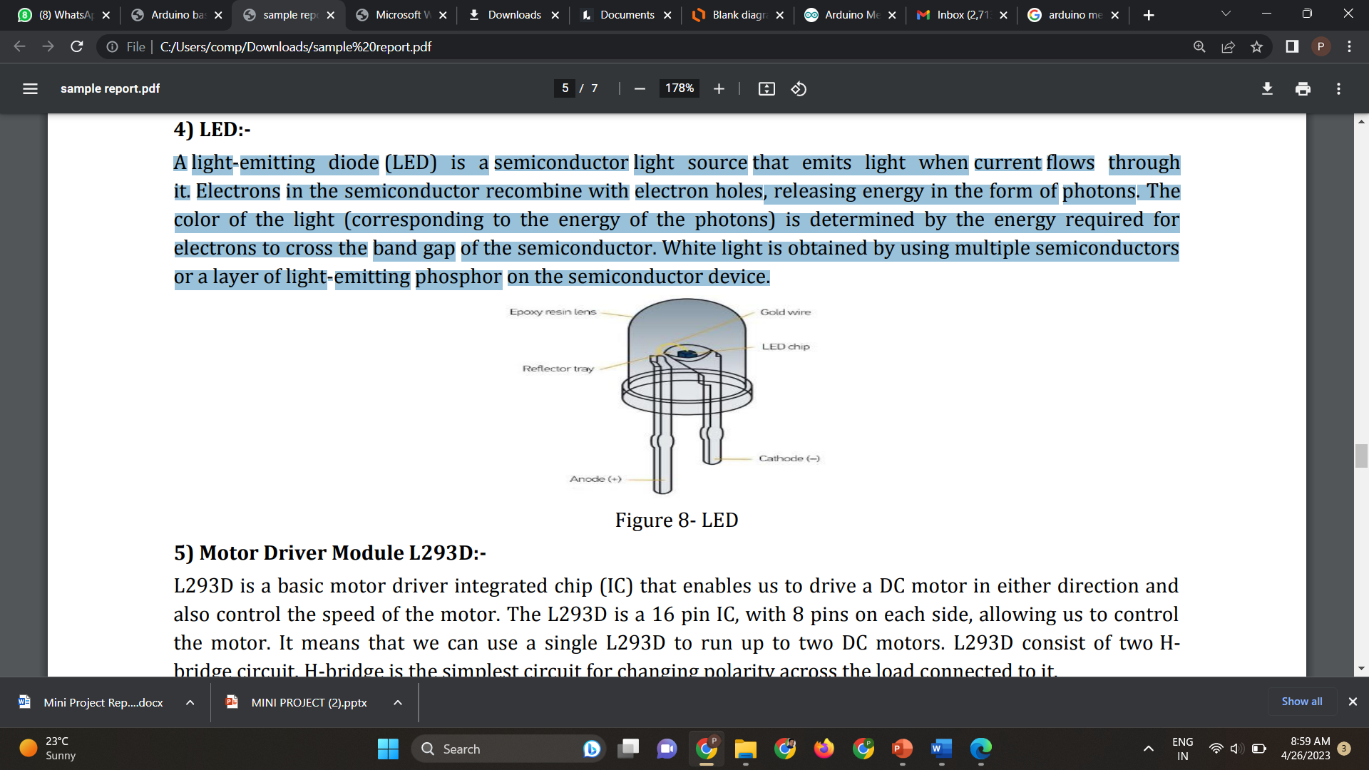
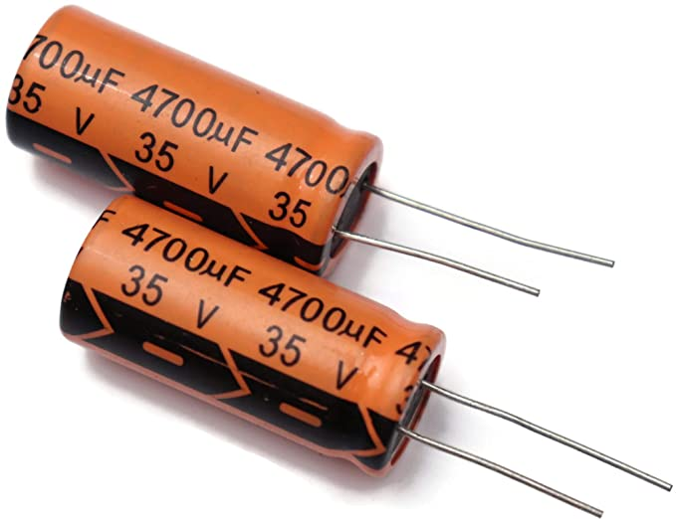
Potentiometer:
The potentiometer is an instrument used to measure the unknown voltage by comparing it with the known voltage. It can be used to determine the emf and internal resistance of the given cell and also used to compare the emf of different cells. The comparative method is used by the potentiometer
LED:
A light-emitting diode (LED) is a semiconductor light source that emits light when current flows through it. Electrons in the semiconductor recombine with electron holes, releasing energy in the form of photons.
Capacitor
A capacitor is a two-terminal electrical device that can store energy in the form of an electric charge. It consists of two electrical conductors that are separated by a distance. The space between the conductors may be filled by vacuum or with an insulating material known as a dielectric.

Slide 8
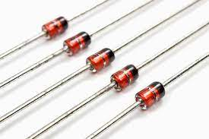
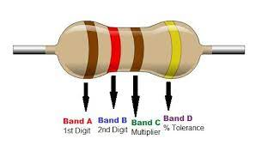
Diode
A diode is a semiconductor device that essentially acts as a one-way switch for current. It allows current to flow easily in one direction, but severely restricts current from flowing in the opposite direction.
Resistor
s. A passive electrical component with two terminals that are used for either limiting or regulating the flow of electric current in electrical circuits.
Battery (3v rechargable battery)
A rechargeable battery, storage battery, or secondary cell (formally a type of energy accumulator), is a type of electrical battery which can be charged, discharged into a load, and recharged many times

Slide 9

SOFTWARE REQUIRED
The Proteus Design Suite is a proprietary software tool suite used primarily for electronic design automation. The software is used mainly by electronic design engineers and technicians to create schematics and electronic prints for manufacturing printed circuit boards.

Slide 10
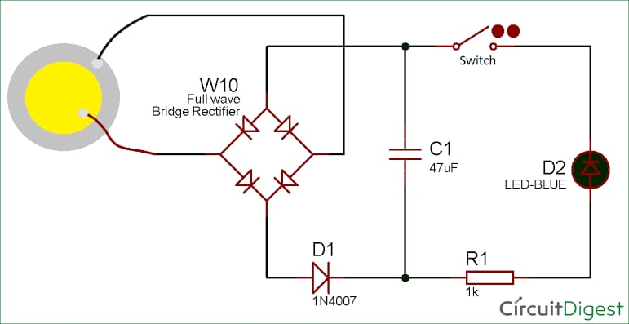
BLOCK DIAGRAM

Slide 11
FEASIBILITY OF PROJECT
Once the scope has been identified, it is reasonable to ask: “Can we build
system to meet this scope? Is the system practical?” The project feasibility
is the focuses on whether the system is useful to the organisation. It
provides an overview of the study requirement or opportunity and
determine if practical solution exist before full lifecycle resource are
committed. The main objective of feasibility study is to test technical,
economic, legal, operational, scheduling feasibility (TELOS) of the
system under development

Slide 12
DESCRIPTION
The process is simple for generating electricity from a piezoelectric crystal that is fairly simple. To turn mechanical energy into electrical energy (the direct piezoelectric effect), metal plates are used to squeeze the crystal. The pressure disturbs the atomic structure and creates an electrical charge which is collected by the plates. More pressure means more electrical power.
When piezoelectric material is placed under mechanical stress, a shifting of the positive and negative charge centers in the material takes place, which then results in an external electrical field. When reversed, an outer electrical field either stretches or compresses the piezoelectric material.The piezoelectric effect is very useful within many applications that involve the production and detection of sound, generation of high voltages, electronic frequency generation, microbalances, and ultra fine focusing of optical assemblies. It is also the basis of a number of scientific instrumental techniques with atomic resolution, such as scanning probe microscopes (STM, AFM, etc). The piezoelectric effect also has its use in more mundane applications as well, such as acting as the ignition source for cigarette lighters

Slide 13
FUTURE SCOPE
In the future, they will be able to detect more than just vibration and pressure. As technology evolves, piezoelectric sensors will be able to detect more than just vibration and pressure.
They will be able to detect environmental factors such as temperature, humidity, and light
We can improve the product design to be more precise and efficient.

Slide 14
CONCLUSION
Piezoelectricity is a revolutionary source for “GREEN ENERGY“
Convert the ambient vibration energy surrounding them into the "ELECTRICAL ENERGY".
This is an excellent alternative to reach the increase the demand of electricity
This technology is tested in "CALIFORNIA" and "ISRAEL" and approved successfully.• We concluded that it should be implemented in "INDIA" also to accelerate the development.
The efficiently converted energy helps us to reduce the scarcity of electric energy across the globe. The purpose of converting mechanical energy to electricity is to reduce the power usage from alternatives sources like solar and inverter.

Slide 15
Thank You

